Slide 1
Welcome to Marketing Research
2
Tom Jopling
MKTG2341 PC Lab 2
WEEK

Slide 2

Today’s Agenda
Introductions
Project Guidelines
Industry Canada Search – posted on Share Out
Advanced Google Search

Slide 3

GROUND RULES
On time (attendance).
Prepared.
Log out when class is finished.
Check that you have not left anything behind.
Leave promptly.
No, it’s not OK if you…
Check your email.
Be on Facebook, etc.
Surf the web.
Work on anything other than class exercises.

Slide 4
Over to you…
Advanced Internet Search
Let's suppose that, we are looking for an article written by a Stanford professor on the causes of mercury poisoning.
We can't recall the name of the professor or anything else about the article.
Get assignment in Share Out MKTG2341.
Hand-in answers in Share In MKTG2341.

Slide 5

Internet Search
STEP 1
In Google's main search screen, type in the term mercury poisoning: and hit search.
Review the results showing on the first page
Write down the total number of results found by the search (top right hand corner of the screen).

Slide 6
Advanced Internet Search
STEP 2
In Google’s Advanced Search screen, type in the term mercury poisoning in the “all of the words".
We want to exclude searches for the planet Mercury. Type the term planet in the "any of these unwanted words" section.
Set display to 30 results on the screen; hit Advanced Search.
Review the results showing on the first page and write down the total number of results.

Slide 7
Specify Domain
STEP 3
Narrow the search to only educational institutions
Still in Google’s Advanced Search screen:
  Complete Step 2 again.
  In the Domain section enter .edu (this will limit the search to educational websites only).
Review the results showing on the first page and write down the total number of results.

Slide 8
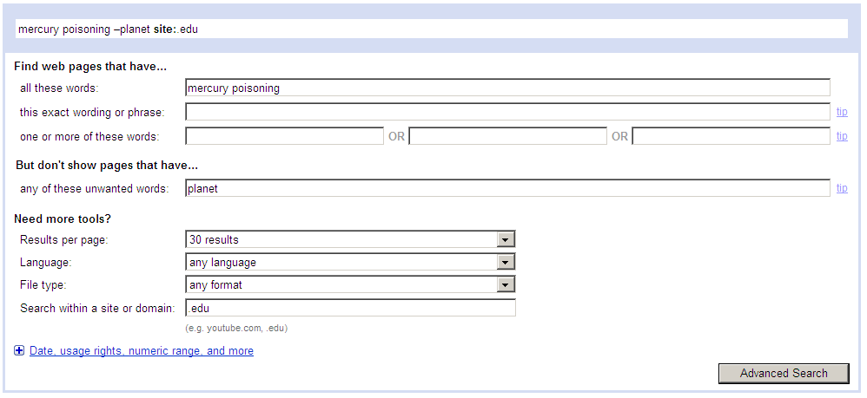
Specify Domain

Slide 9
Specify Domain
STEP 4
Complete Step 3 again.
In the Domain section enter stanford.edu (this will limit the search to the Stanford website).
Review the results and write down the total number of results: ___________
Click on the first article. What date was it published? ___________

Slide 10
Specify Date
STEP 5
Complete Step 4 again.
However, this time click on Date and specify the Date to Past Year.
Review the results showing on the first page and write down the total number of results.
Click on the first article. What year was it published?

Slide 11
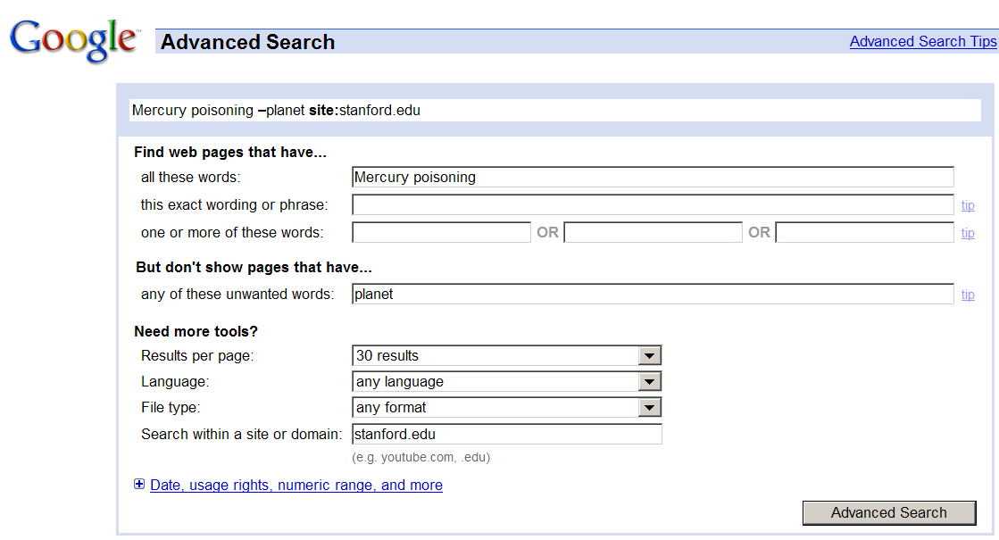
Specify Date

Slide 12
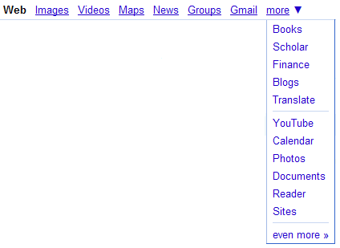
Even Better Searching
Check out the more icon on the search bar.
  Long list of search options.
  Ex: videos, scholar (university) sites, financial information etc.
Use more search parameters:
  Limit the language (e.g. English).
  Set file format (e.g. pdf, ppt, xls, etc).

Slide 13
Even Better Searching
A lot of "extras" you can use in Google.
Check out Google’s cheat sheet and help lists:
  http://www.google.com/help/cheatsheet.html
  http://www.google.com/help/operators.html
  http://www.google.com/intl/en/help/features.html
If you prefer video of much the same check out:
  http://www.metacafe.com/watch/789028/google_search_hacks
  http://www.expertvillage.com/video/40947_google-search-stock-quotes.htm [a whole range of the small videos on using Google]

